Slide 1
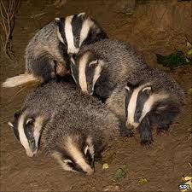
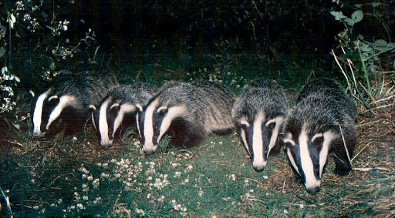
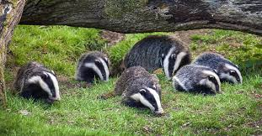
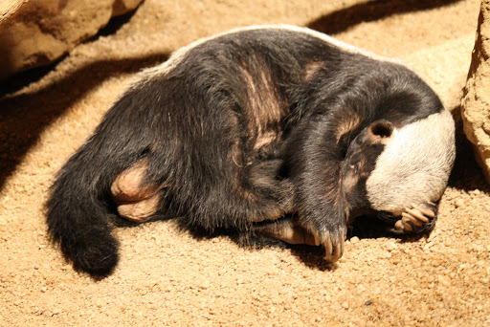

How Do Badgers Live Underground
By Miheli Jayasuriya
Base 3

Slide 2
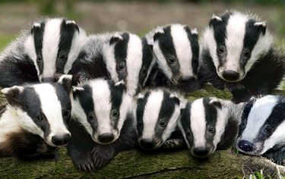
Cete , Clans, Setts and their food
The biggest underground homes in Britain belong to badgers. These animals are very sociable and love to play. They live in group called Cete or Clans and their homes are called setts. In the wild, badgers like to dig their setts in large area which is known as their territory. A territory is a stench of land that is around 1,000 meters in length and it width is around 500 meters. Also a territory is where they look for food. They eat food such as fruit, birds eggs, slug, rabbits, mice, moles and frogs but their diet is mostly earthworms.
The main sett is the place where they stay for most of the year and they will have their babies. There are other setts however they are smaller. Badgers use the smaller setts in the spring, summer and autumn where there is lots of food around because they can find their dinner and stay in one of the smaller setts for a little rest. There might be up to six badgers in each territory. Badgers are really smart to have a few other homes. Wouldn't that be nice?

Slide 3
Did You Know…
Badgers know which territory is theirs because of their toilets which are called latrines. Badgers have really distinct smelling poo which they put at the end of their territory so other badgers know do not to enter.
Badgers can run up to 19 miles per hour. This helps when hutting and getting chase by other predators.
Badgers do not hibernate but they may be less active in winter.
Badgers are omnivores which is meat and plants.

